Slide 1
Basic java web application
Kms technology
2017 OCT 20

Slide 2
Agenda
Architecture of Java Web Application
Java Servlet Technology
Template Engine (Thymeleaf)
JDBC
Java frameworks

Slide 3
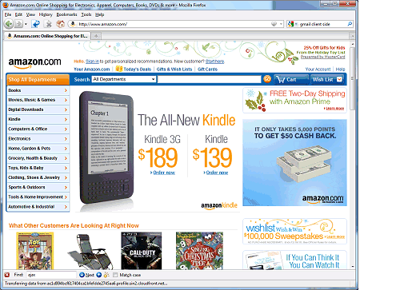



High-Level Architecture of a Web Application
Internet
Web server
Client (web browser)
User

Slide 4
Static Web Pages

Slide 5
Dynamic Web Pages
The web application dynamically generates the HTML for a web page that contains elements based on the request parameters.

Slide 6
HTTP Request and Response
A client sends an HTTP request to a server which contains the URL of a resource
A request also includes:
The type of user agent (the client browser and its version)
The types of resources that will be accepted (text, image, etc.)
The server responds with an HTTP response
Status line – HTTP version, status code and message
Header lines – information about the resource
Message body – contains the requested object

Slide 7
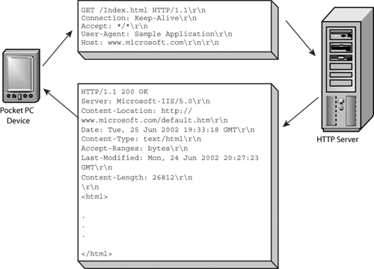
HTTP Request and Response

Slide 8
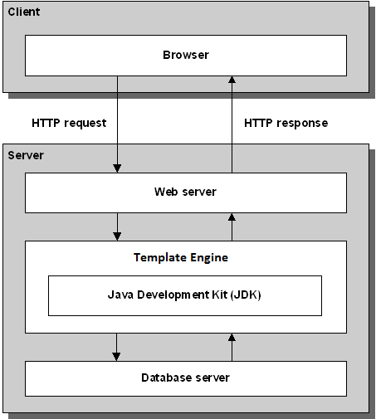
Architecture of a Java Web Application
Microsoft Explorer
Firefox
Google Chrome
Apple Safari
Tomcat
MySQL Relational
Database Manager

Slide 9
Technologies and Tools
Template Engines (Thymeleaf)
Generate dynamic web pages
Java servlets and JavaBeans
Server-side web application logic
SQL and JDBC programming
Tomcat
Tools
Integrated development environment (IDE)
Maven/Gradle

Slide 10
Java Servlet Technology
A servlet class extends the capabilities of servers that host the applications accessed by the way of request-response programming model.

Slide 11
A simple Servlet
package testPackage;
import java.io.*;
import javax.servlet.*;
import javax.servlet.annotation.*;
import javax.servlet.http.*;
@WebServlet("/hello")
public class HelloWorld extends HttpServlet {
@Override
public void doGet(HttpServletRequest request,
HttpServletResponse response)
throws ServletException, IOException {
response.setContentType("text/html");
PrintWriter out = response.getWriter();
out.println("<html><head><title>Hello</title></head>");
out.println("<body>Hello World</body></html>");
}
}

Slide 12
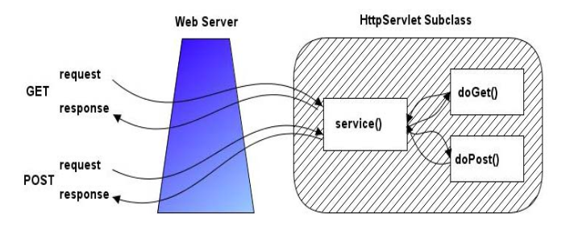
Servlet Methods

Slide 13
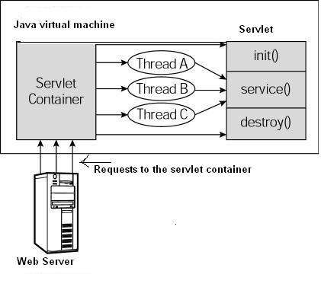
Servlet life cycle

Slide 14
Reading Data In Servlets
request.getParameter("name")
Returns URL-decoded value of first occurrence of name in query string
request.getParameterValues("name")
Returns an array of the URL-decoded values of all occurrences of name in query string
request.getParameterNames() or request.getParameterMap()
Returns Enumeration or Map of request params

Slide 15
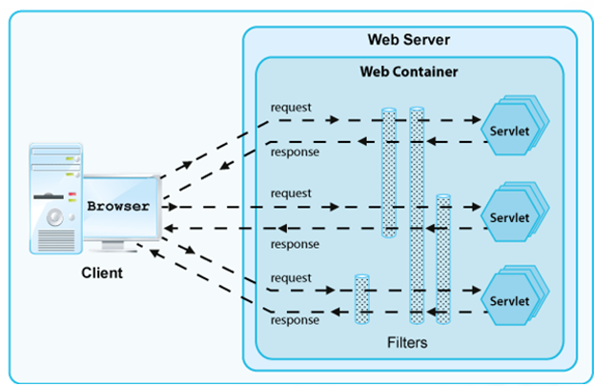
Filter

Slide 16
filter
@WebFilter(urlPatterns = "/forbidden")
public class TestFilter implements Filter {
@Override
public void doFilter(ServletRequest req, ServletResponse res, FilterChain chain) throws IOException, ServletException {
boolean ok = false;
if (ok) {
chain.doFilter(req, res);
} else {
PrintWriter out = res.getWriter();
out.println(Constants.HTML_START + "<h2>Rejected !!!" + Constants.HTML_END);
}
}
}

Slide 17
listener
Servlet context listeners
These listeners are notified when the servlet context (i.e., the Web application) is initialized and destroyed.
Servlet context attribute listeners.
These listeners are notified when attributes are added to, removed from, or replaced in the servlet context.
Session listeners.
These listeners are notified when session objects are created, invalidated, or timed out.
Session attribute listeners.
These listeners are notified when attributes are added to These listeners are notified when attributes are added to, removed from, or replaced in any session.

Slide 18
listener
@WebListener
public class MyServletListener implements ServletContextListener {
@Override
public void contextDestroyed(ServletContextEvent event) {
// TODO Clean up/release any resource if needed.
}
@Override
public void contextInitialized(ServletContextEvent event) {
// TODO setup application-wide resource: database connection pool
// TODO Read the initial values of application-wide data that will be
// used by multiple servlets and JSP pages.
System.out.println(evnt.getServletContext().getInitParameter("jdbc.host"));
System.out.println(evnt.getServletContext().getInitParameter("jdbc.port"));
}
}

Slide 19
The Need OF Template Engine
With servlets, it is easy to
Read form data
Read HTTP request headers
Set HTTP status codes and response headers
Use cookies and session tracking
Share data among servlets
Remember data between requests
But, it sure is a pain to
Use those println statements to generate HTML
Maintain that HTML

Slide 20
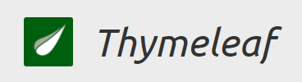
What is thymeleaf ?
A template engine for Java
Open Source
First version 2011 – current version 3.0
It processes HTML, XML, JS, CSS, Text
Usually view layer in SpringMVC.

Slide 21
Thymeleaf Expressions
Variable Expressions: ${…}
Selection variable expressions: *{…}
Message expression: #{…}
Link URL expression: @{…}
Fragment expression: ~{…}

Slide 22
Thymeleaf basic objects
#ctx
#vars
#locale
#request
#response
#session
#servletContext

Slide 23
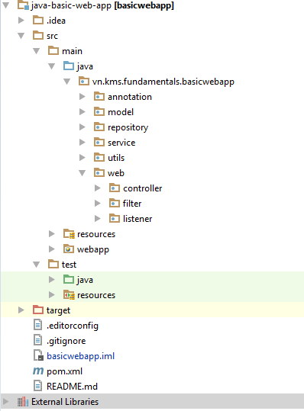
Java web project structure

Slide 24
What Are Beans?
Java classes that follow certain conventions
Must have a zero-argument (empty) constructor
Should have no public instance variables (fields)
Persistent values should be accessed through methods called getXxx and setXxx
public class StringBean {
private String message = "No message specified";
public String getMessage() {
return(message);
}
public void setMessage(String message) {
this.message = message;
}
}

Slide 25
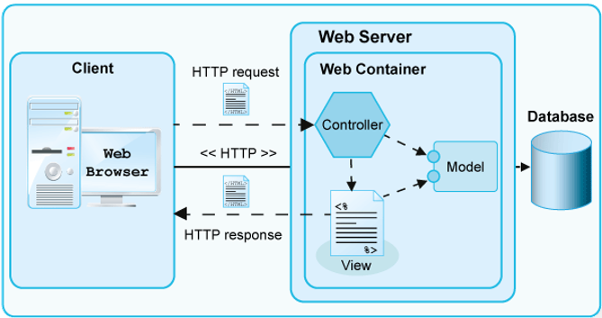
MVC architecture

Slide 26
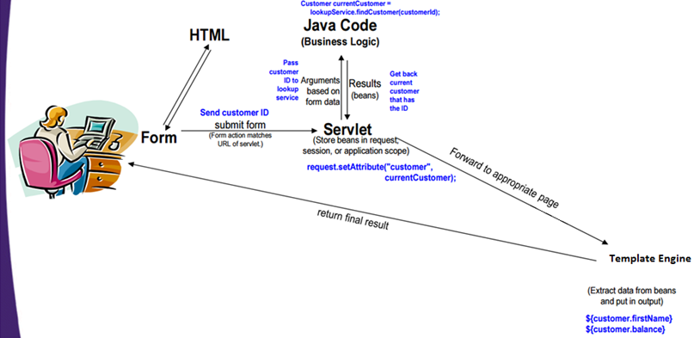
MVC Flow of Control

Slide 27
Implementing MVC
Define beans to represent result data
Use a servlet to handle requests
Obtain bean instances
Store the bean in the request, session, or servlet context
Forward the request to a page
Extract the data from the beans

Slide 28
Access to Databases
... web browsers ...
Internet
Web Application Sever
Database

Slide 29
JDBC Introduction
The Java DataBase Connectivity:
is the industry standard for providing connectivity between a Java application and a database
allows to use Java programing language to enable applications access varied data sources
allows to perform the following tasks:
Connect to a database.
Execute SQL statements.
Process the results or data retrieved by executing the SQL statements

Slide 30
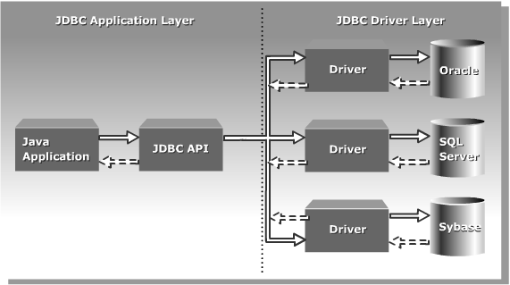
JDBC ARchitecture

Slide 31
Basic Steps in Using JDBC
Define the Connection URL
Establish the Connection
Create a Statement object
Execute a query
Process the results
Close the connection
String connectionUrl = "jdbc:<vendorName>//<host>:<port>/<dbName>";
Properties userInfo = new Properties();
userInfo.put("user", "username");
userInfo.put("password", "secret");
Connection connection = DriverManager.getConnection(connectionUrl, userInfo);
connection.close();

Slide 32
Make a Statement
A Statement is used to send queries or commands
Statement
PreparedStatement
CallableStatement
Statement statement = connection.createStatement();

Slide 33
Execute a Query
statement.executeQuery
This version returns a ResultSet
statement.executeUpdate
statement.execute
String query = "SELECT col1, col2, col3 FROM sometable";
ResultSet resultSet = statement.executeQuery(query);

Slide 34
Process the result
Important ResultSet methods
resultSet.next()
Goes to the next row. Returns false if no next row.
resultSet.getString("columnName")
Returns value of column with designated name in current row, as a String. Also getInt, getDouble, getBlob, etc.
resultSet.getString(columnIndex)
Returns value of designated column. First index is 1
while(resultSet.next()) {
System.out.println(resultSet.getString("address"));
}

Slide 35
Using Prepared Statements
Make a placeholder
Substitute in values
Execute command
String template = "INSERT INTO someTable VALUES(?, ?)";
PreparedStatement inserter = connection.prepareStatement(template);
inserter.setInt(1, someInt);
inserter.setString(2, someString);
inserter.executeUpdate();

Slide 36
Transactions
By default, after each SQL statement is executed the changes are automatically committed to the database
Turn auto-commit off to group two or more statements together into a transaction
Call commit to permanently record the changes to the database after executing a group of statements
Call rollback if an error occurs
connection.setAutoCommit(false);
connection.commit();
connection.rollback();

Slide 37
Transactions: Example
Connection connection = DriverManager.getConnection(url, userProperties);
connection.setAutoCommit(false);
try {
statement.executeUpdate(...);
statement.executeUpdate(...);
...
connection.commit();
} catch (Exception e) {
try {
connection.rollback();
} catch (SQLException sqle) {
// report problem
}
} finally {
try {
connection.close();
} catch (SQLException sqle) { }
}

Slide 38

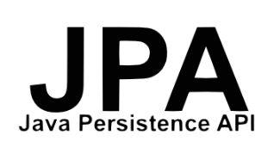


Persistence Libraries

Slide 39




Web framework

Slide 40




Application framework

